Slide 1
Visual and tactile based shared control for remote palpation
Jingwen Zhao
Supervisor: Fumiya Iida, Thilina Dulantha Lalitharatne, Leone Costi
Bio-Inspired Robotics Laboratory

Slide 2
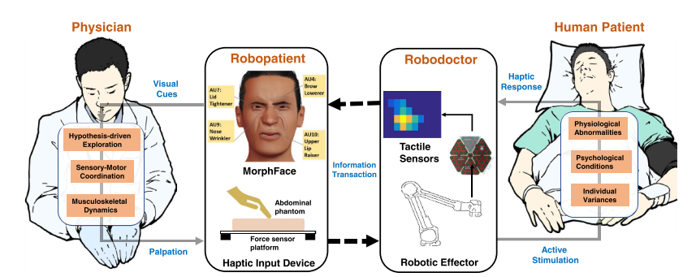
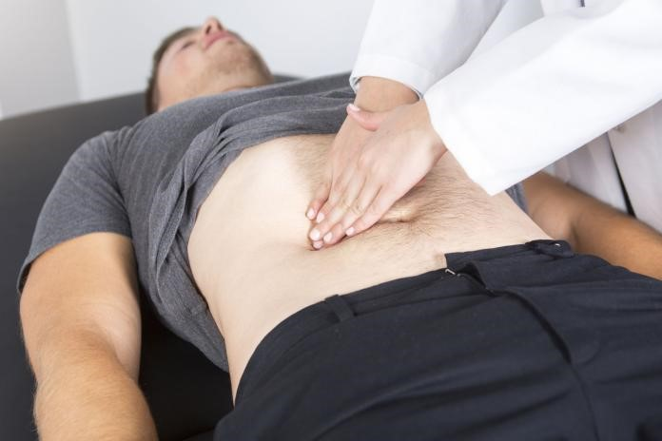
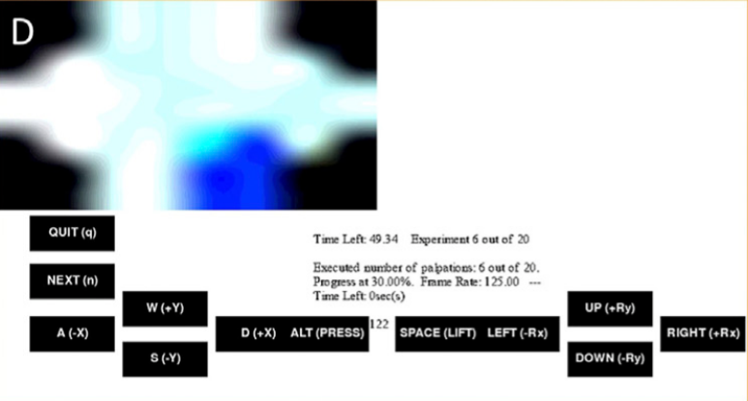
Palpation & remote palpation
GUI
[1] Lalitharatne, T.D., et al., Face mediated human–robot interaction for remote medical examination. Scientific Reports, 2022. 12(1).
Notes:
Palpation is the process of using one's hands to check the body of patient during a physical examination. As simple as the action may seem, it can provide information all the way from just beneath the skin to organs deep inside the body. An experienced examiner is able to, for example tell from the tenderness of muscle to know whether there might be any damage or infection, or even guess a potential spot of cancer from the inconsistency of the organ texture.
What I’m trying to study here, is the potential of remote palpation. We’ve had remote etc, or even davinci for remote surgical operation. So what about remote palpation? As simple as it may sounds, it’s a very complicated process to model as there’s so many complicated interaction between the pose of the hand or the position of the patient etc. The doctor then reads all these intricate information from the subtle difference on their fingertip.
We can start with a simple paradigm of remote palpation. ..

Slide 3
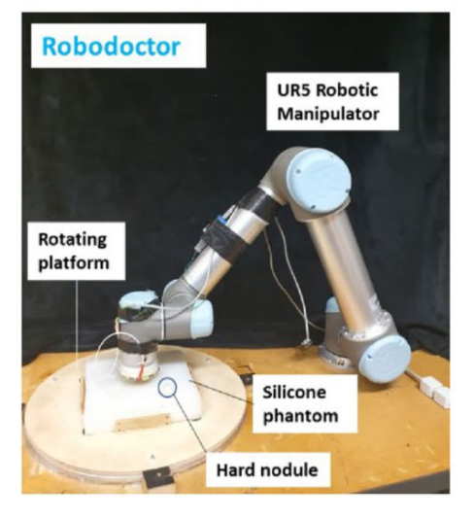
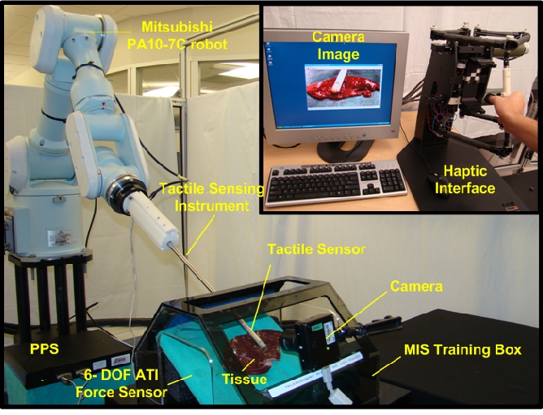
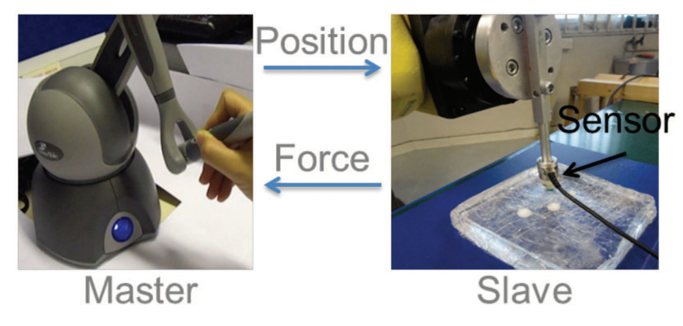
Remote palpation: past work
Palpation along linear path only
Returns pressure map
Potential damage to tissue
Freedom of palpation point
Point wise result only
[2] Talasaz, A. and R.V. Patel. Remote palpation to localize tumors in robot-assisted minimally invasive approach. in 2012 IEEE International Conference on Robotics and Automation. 2012. IEEE.
[3] Konstantinova, J., et al. Evaluating manual palpation trajectory patterns in tele-manipulation for soft tissue examination. in 2013 IEEE International Conference on Systems, Man, and Cybernetics. 2013. IEEE.
[4] Lalitharatne, T.D., et al., Face mediated human–robot interaction for remote medical examination. Scientific Reports, 2022. 12(1).
Freedom of palpation point
Return pressure map

Slide 4
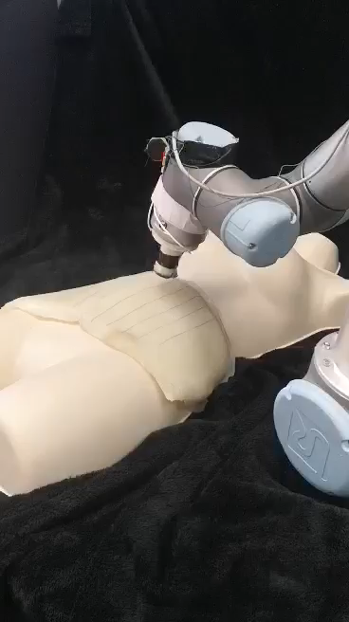
Shared control
Problem:
Capable of dextrous task but difficult to control
Solution: Shared Control
Let the robot perform what the doctor WANT to perform
Target:
Enable user to perform complex palpation task with current system
Notes:
HOWEVER, not much application is seen in the healthcare and will be the key to unlock the full potential of our remote palpation system
Hazardous waste handling, autonomous driving, prosthetic limb
Widely used in fields such as hazardous waste handling, autonomous driving, prosthetic limb

Slide 5
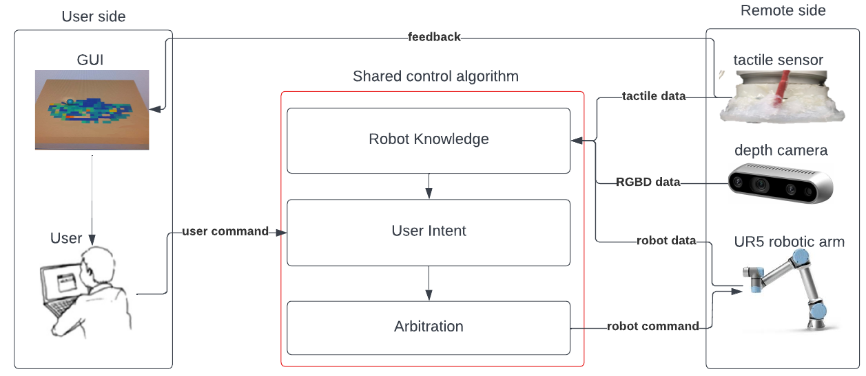
Shared control system paradigm

Slide 6
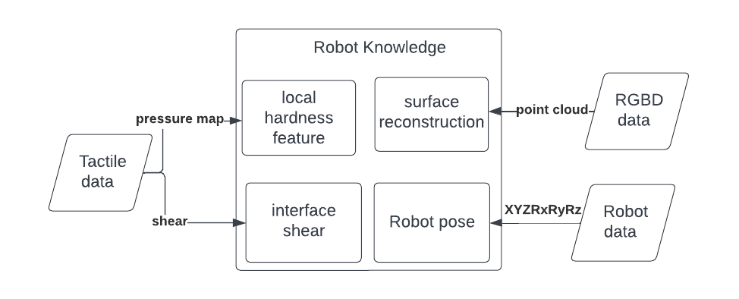
Shared control system paradigm

Slide 7
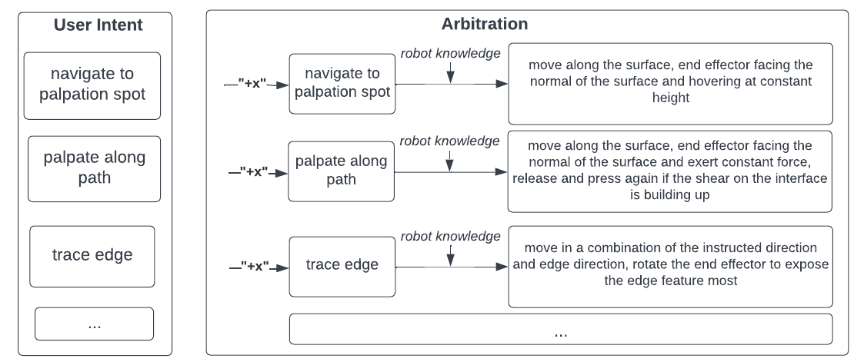
Shared control system paradigm
“+X”

Slide 8
Shared control system paradigm
“+X”

Slide 9
Shared control system paradigm
“+X”

Slide 10
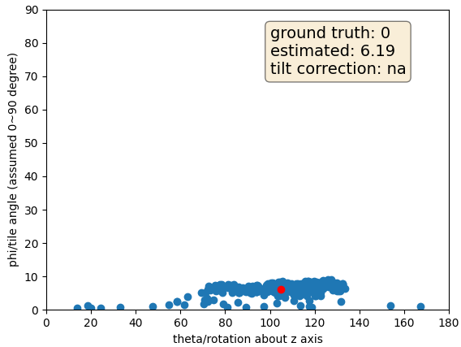
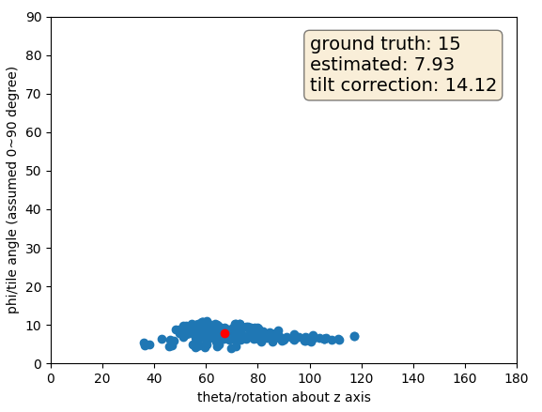
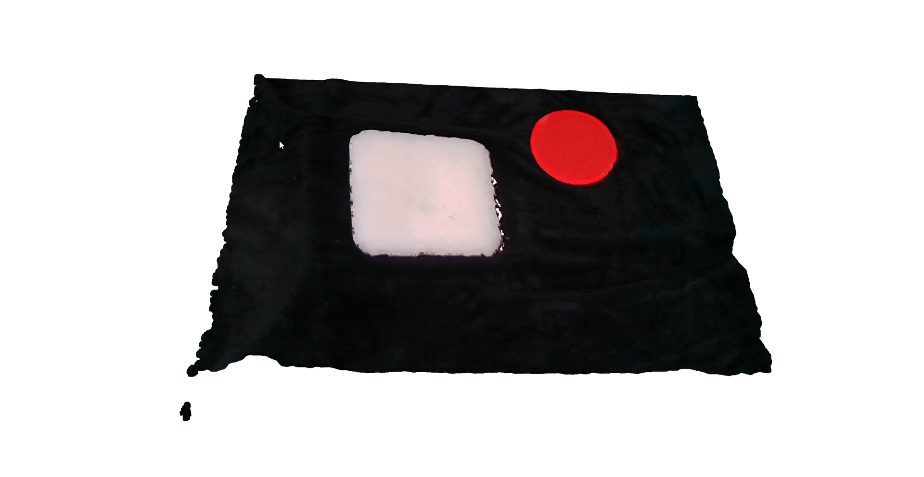
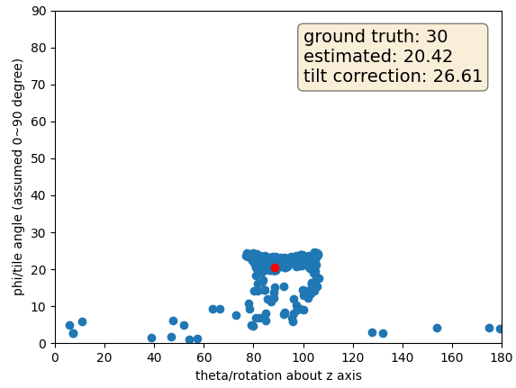
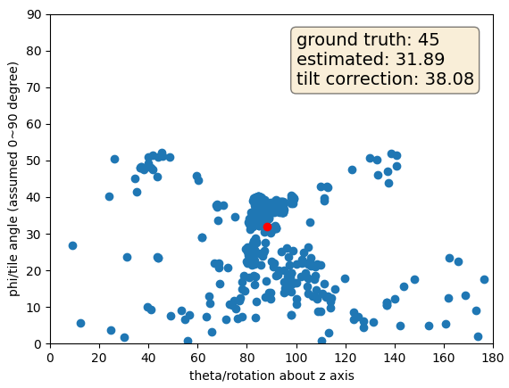
Current progress
Warm up task: reconstruction with flat phantom

Slide 11
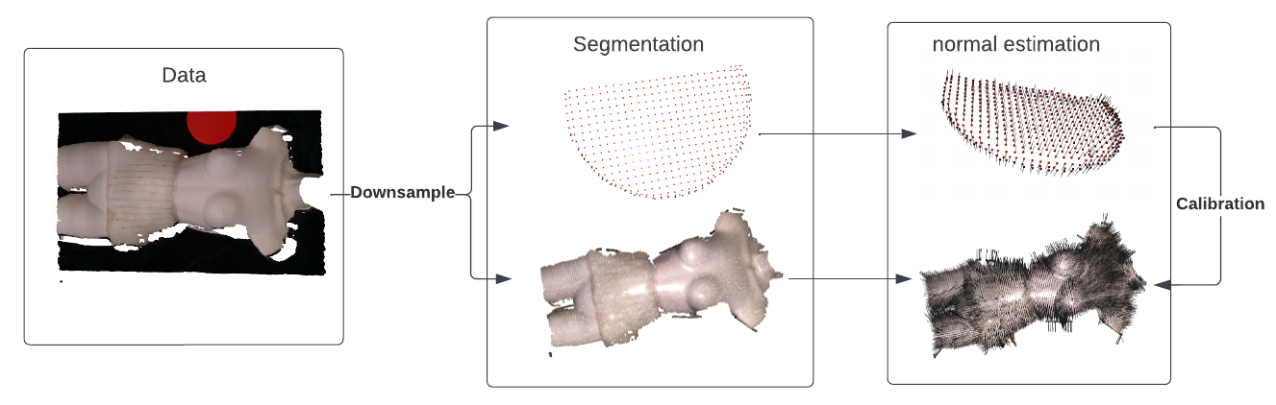
Current progress
Reconstruction with abdominal phantom on mannequin

Slide 12
Next Step
Robot knowledge
extract tactile pressure map feature and shear
Arbitration
Orient probe normal to the surface
Release and press again at large shear
Orient probe to expose local hardness feature
Perform user study on complicated palpation task

Slide 13
Thank you
Q&A

